Slide 1
As you come in…
Define these keywords
ion
dot and cross diagram
Use a Periodic Table to complete the table
non–metal | charge | non-metal ion
fluorine | 1– | F–
oxygen
chlorine
sulfur
bromine
Answer these questions
Why do non–metals form negatively charged ions? Oxygen is in Group 6 of the periodic table. Draw a dot–and–cross diagram to show the formation of the O^{2–} ion.

Slide 2

Define these keywords
ion | An atom or molecule that has lost or gained one or more electrons so has a charge.
dot and cross diagram | Shows how chemical bonds are formed between atoms.
Use a Periodic Table to complete the table
non–metal | charge | non-metal ion
fluorine | 1– | F–
oxygen
chlorine
sulfur
bromine
2-
O²⁻
1-
Cl⁻
2-
S²⁻
Answer these questions
Why do non–metals form negatively charged ions?
To increase their stability by having a full outer shell of electrons. They gain one or more electrons, so are negatively charged overall.
1-
Br⁻

Slide 3
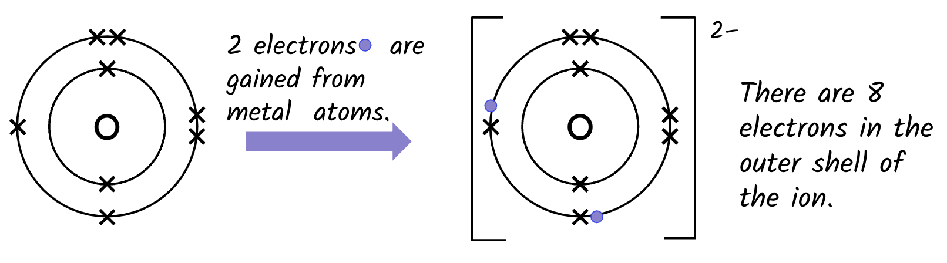
Define these keywords
ion | An atom or molecule that has lost or gained one or more electrons so has a charge.
dot and cross diagram | Shows how chemical bonds are formed between atoms.
Use a Periodic Table to complete the table
non–metal | charge | non-metal ion
fluorine | 1– | F–
oxygen
chlorine
sulfur
bromine
2-
O²⁻
1-
Cl⁻
2-
S²⁻
Answer these questions
Oxygen is in Group 6 of the periodic table. Draw a dot–and–cross diagram to show the formation of the O^{2–} ion.
1-
Br⁻

Slide 4
2 electrons are gained from metal atoms.
2–
There are 8 electrons in the outer shell of the ion.
O
O

Slide 5

Why elements react to form compounds
covalent bonding
Lesson Objectives
To explain how covalent bonds are formed.
To write the formulae of some covalent compounds.
On your mini-whiteboards:
Draw a diagram, with outer electrons only, to show how the electrons are transferred when magnesium chloride MgCl₂ is formed from its elements.
Keywords: dot-and-cross diagram, non-metal, covalent bonding

Slide 6
Covalent bonding
Meeting | Exceeding | Mastering
I can describe covalent bonding as the combining of two or more nonmetal atoms. | I can explain how atoms will share valence electrons and form covalent molecules. | I can use the periodic table to draw accurate dot and cross diagrams of single, double or triple covalent bonds.

Slide 7
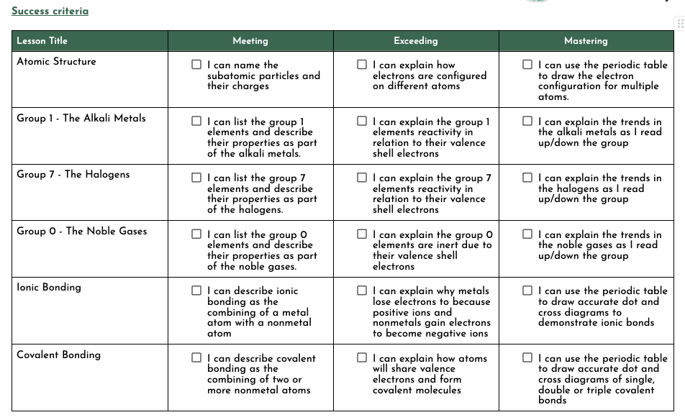

Slide 8
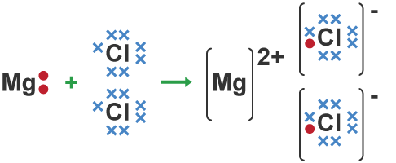
Draw a diagram, with outer electrons only, to show how the electrons are transferred when magnesium chloride MgCl₂ is formed from its elements.
Notes:
TO ADD - I will add a photo of my own drawing to this slide before the lesson

Slide 9
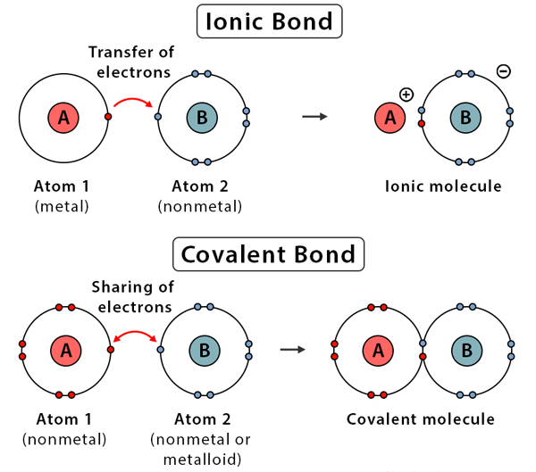
Ionic and covalent bonding
Atoms are more stable when the outermost electron shell is completely full of electrons.
Elements react to form compounds to do this. The elements are held together by chemical bonds by:
Atoms losing or gaining electrons (ionic bond)
Atoms sharing electrons (covalent bond)

Slide 10
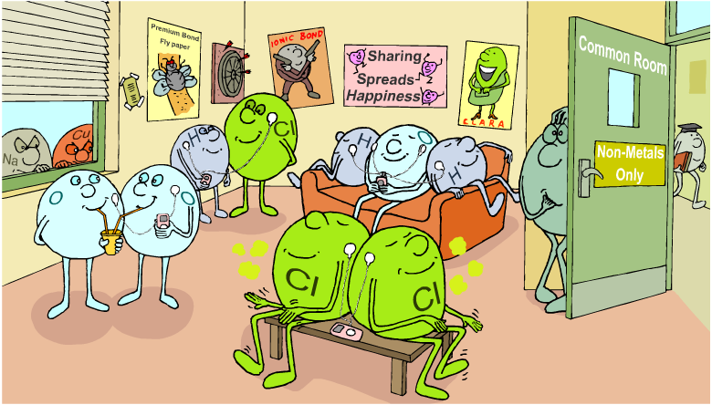

Slide 11
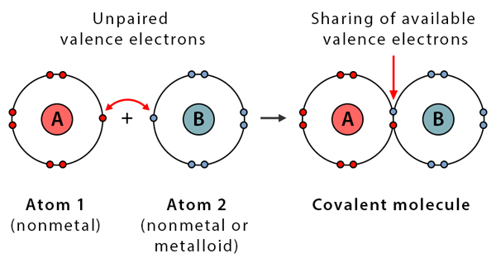
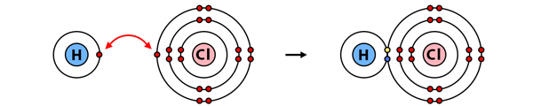
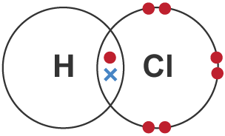
Covalent bonding
When a non-metal forms compounds with other non-metals they do so by sharing electrons to fill their outermost electron shells to form a covalent bond.
Covalent bonds are strong – a lot of energy is needed to break them.
Compounds that have covalent bonds are known as covalent compounds.
E.g.

Slide 12
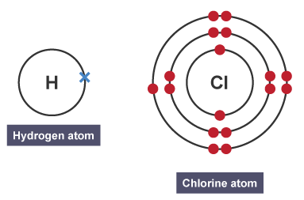
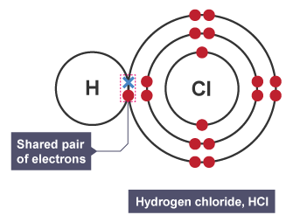

Covalent bonding
A hydrogen atom with 1 electron and a chlorine atom with 17 electrons
The hydrogen atom has bonded with the chlorine atom, meaning there is now a shared pair of electrons

Slide 13

Draw covalent molecules for:
1. Hydrogen (H₂)
H = Group 1 in the Periodic table
2. Oxygen (O₂)
O = Group 6
3. Water (H₂O)
H = Group 1 , O = Group 6
4. Methane (CH₄)
C = with 6 electrons in outer shell, H = Group 1
5. Ammonia (NH₃)
N = with 7 electrons in outer shell, H = Group 1
Extension:
Read Learner’s book page 76 + 77
Complete Exercise 2.4A in Workbook (page 39)

Slide 14
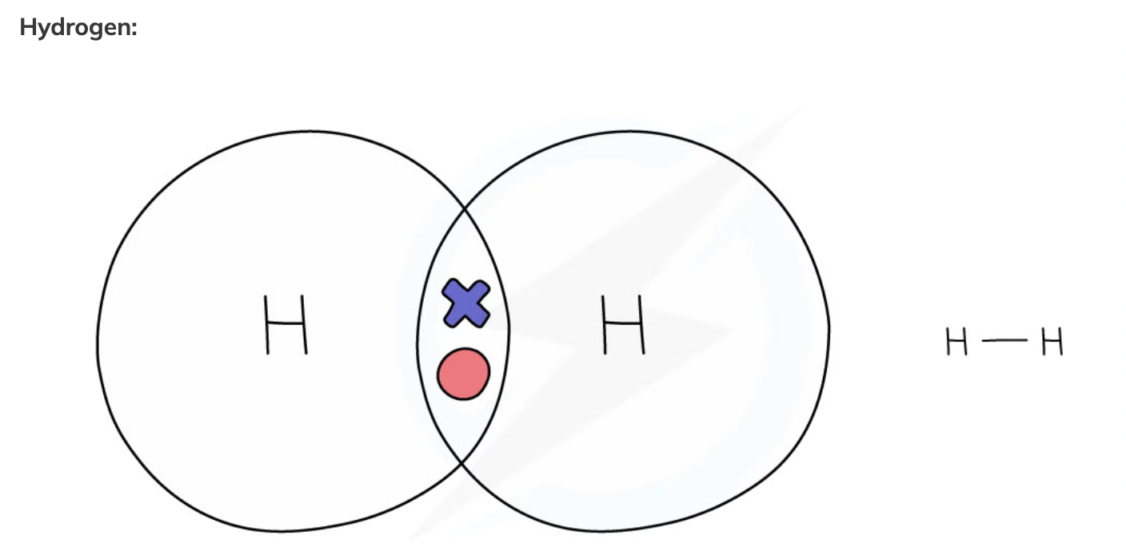

Slide 15
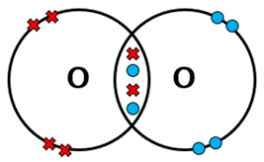

Oxygen:
Oxygen can share two electrons with another oxygen atom. This creates a double bond.

Slide 16
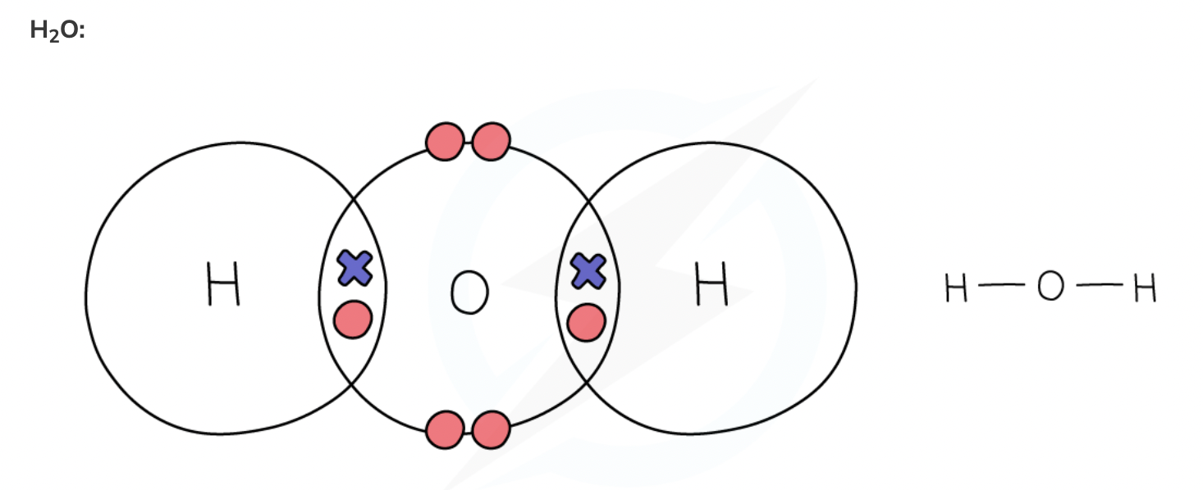

Slide 17
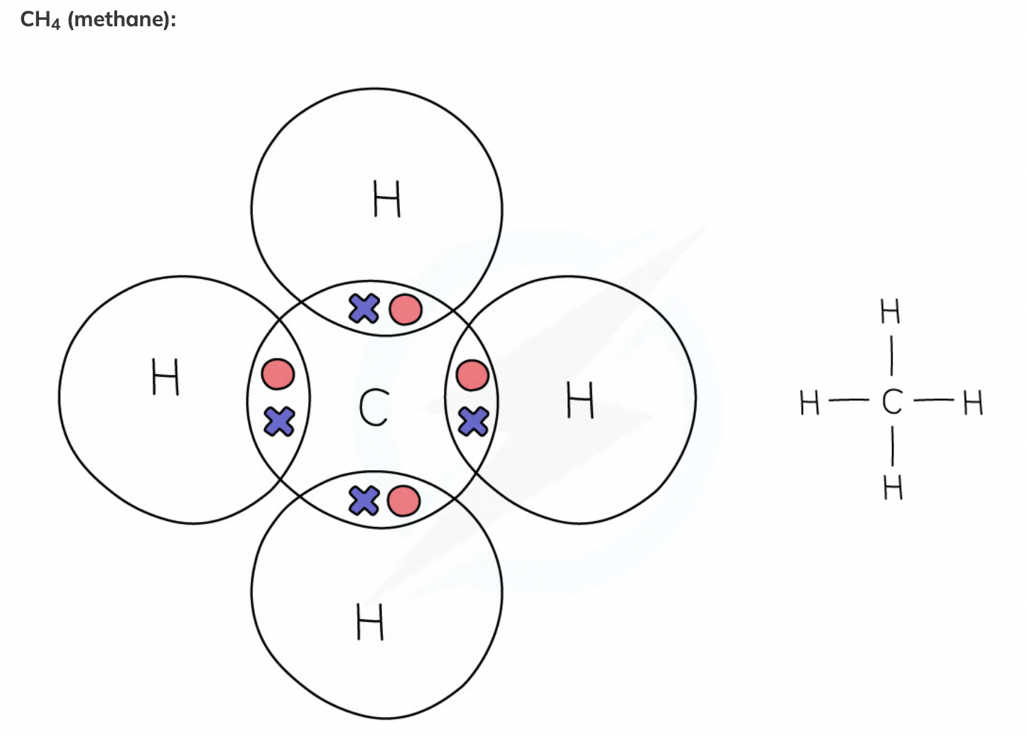

Slide 18
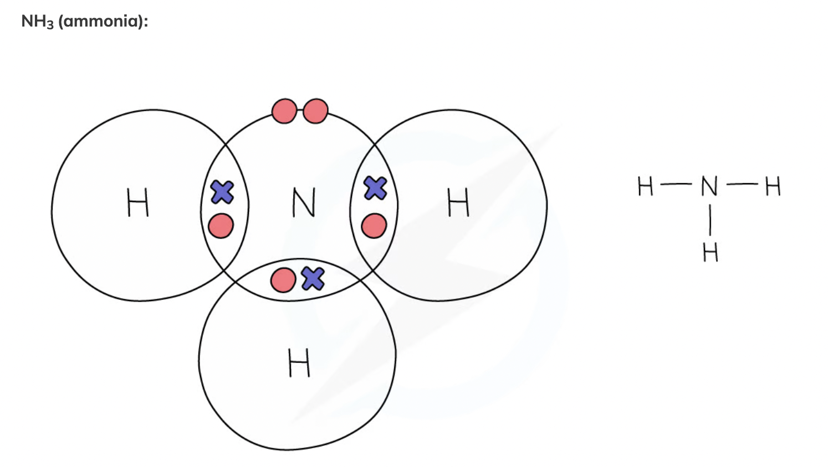

Slide 19
Ionic or covalent?!
NaCl
IONIC
Think: How do I know if a compound is ionic or covalent?
Notes:
ionic

Slide 20
Ionic or covalent?!
MgBr₂
IONIC
Think: How do I know if a compound is ionic or covalent?
Notes:
ionic

Slide 21
Ionic or covalent?!
CO₂
COVALENT
Think: How do I know if a compound is ionic or covalent?
Notes:
covalent

Slide 22
Ionic or covalent?!
C₆H₁₂0₆
COVALENT
Think: How do I know if a compound is ionic or covalent?
Notes:
covalent

Slide 23
Ionic or covalent?!
K₂O
IONIC
Think: How do I know if a compound is ionic or covalent?
Notes:
ionic

Slide 24
Ionic or covalent?!
CuCl₂
IONIC
Think: How do I know if a compound is ionic or covalent?
Notes:
ionic

Slide 25
Ionic or covalent?!
O₂
COVALENT
Think: How do I know if a compound is ionic or covalent?
Notes:
covalent

Slide 26
Ionic or covalent?!
CH₄
COVALENT
Think: How do I know if a compound is ionic or covalent?
Notes:
covalent

